Slide 1
Lexical Analysis
COP 4020
Pete Dobbins

Slide 2
Overview of Language Translation
Lexical Analysis
Parsing
Static Semantic Analysis
Code Generation

Slide 3
Overview of Language Translation
Lexical Analysis
Performed by a Lexer or Scanner.
Convert sequence of characters into a sequence of potential tokens.
Lexical structure typically specified with regular expressions.
Parsing
Static Semantic Analysis
Code Generation

Slide 4
Overview of Language Translation
Lexical Analysis
Parsing
Performed by a Parser.
Recognizes legal phrases [token order] using the rules of a grammar (CFG).
Converts token sequence into an Abstract Syntax Tree (AST).
Does not use regular expressions.
Static Semantic Analysis
Code Generation

Slide 5
Overview of Language Translation
Lexical Analysis
Parsing
Static Semantic Analysis
Type checking is completed.
Code Generation

Slide 6
Overview of Language Translation
Lexical Analysis
Parsing
Static Semantic Analysis
Code Generation
May involve several phases, depending up on how much optimization is included.

Slide 7
Syntax vs Semantics
Syntax describes the structure of a language.
Semantics describe the meaning that may be found in the language.
It is convenient to consider syntax and semantics separately.
Syntax is much easier to describe.

Slide 8
Syntax
Lexical Structure: legal tokens [words]
Phrase Structure: how tokens may be arranged
if ( balance < 0 ) {
return “Account Overdrawn”;
}

Slide 9
Lexical Structure
Token | Kind
if | keyword
( | left paren
balance | identifier
< | operator
0 | numerical literal
) | right paren
{ | left brace
return | keyword
“Account Overdrawn” | string literal
; | semicolon
} | right brace
Defines how the character sequence is divided into a sequence of tokens.

Slide 10
Phrase Structure [briefly for now…]
According to phrase structure, this is a legal statement
The if keyword is followed by an expression enclosed in parentheses,
Which is followed by a block enclosed in braces
That contains a statement terminated with a ;
if ( balance < 0 ) {
return “Account Overdrawn”;
}

Slide 11
Lexical Structure
Q: Why do we use formal notation?
A: Precise definition ensures lexical rules are clear.
Java, C, C++… YES!
Rational Constants
is .1 allowed?
is 10. allowed?
Rational Constants
1..15 is a rang specifier
Scanner might confuse
this with 1. and .15!
Pascal, Ada … NO!

Slide 12
Example: [simple] Numeric Literals
We give names [labels] to regular expressions and use them in other regular expressions as if they were symbols.
<num lit> ::= <nonzero digit> <digit>* | 0
<digit> ::= 0 | <nonzero digit>
<nonzero digit> ::= 1 | 2 | 3 | 4 | 5 | 6 | 7 | 8 | 9
Orange denotes a literal character values.

Slide 13
Example: Identifiers
<identifier> ::= <identifier start> <identifier start>*
<identifier start> ::= A..Z | a..z | $ | _
<identifier part> ::= <identifier start> | <digit>

Slide 14

Example: Operators
<input> ::= <token>*
<token > ::= <identifier> | <num list> | <op>
<op> ::= + | == | *
Implicitly: $Σ$ = {A..Z, a..z, 0..9, _, +, =, *}

Slide 15
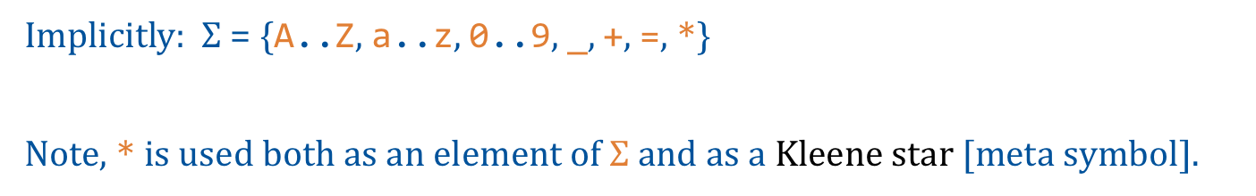
Example: Operators
<input> ::= <token>*
<token > ::= <identifier> | <num list> | <op>
<op> ::= + | == | *
Implicitly: $Σ$ = {A..Z, a..z, 0..9, _, +, =, *}
Note, * is used both as an element of $Σ$ and as a Kleene star [meta symbol].

Slide 16
Example: Inline Comments and Not()
<inline comment> ::= // (Not(EOL))*
Single line comment.
Within the sequence of characters making up the comment, the end-of-line (EOF) character is not allowed.
Not(element): represents negation of the element listed.

Slide 17
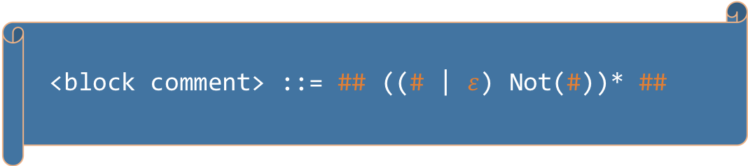
Example: Block Comments
<block comment> ::= ## ((# | $ε$) Not(#))* ##
Comment delimited by ##.
What is the shortest legal string?
Which of these are legal strings?
##abc##
##abc##abc##
##abc#abc##

Slide 18
Recognizing Tokens
REs specify or generate tokens.
We need to recognize tokens.
A Deterministic Finite Automaton (DFA|DFSM) is used to recognize the language that can be generated by a given RE.
We call this part of compilation Lexical Analysis.
The interpreter | compiler component that performs lexical analysis is called a Scanner or Lexer.

Slide 19
Scanners
Responsible for tokenizing source as specified by RE.
Also:
Removing comments
[often] dealing with pragmas [significant comments]
Saving text of identifiers, numbers, strings
Saving source locations [file, line, column] for error message

Slide 20
Building Scanners
Ad-hoc
Semi-mechanical pure DFA [usually realized as nested case statements]
Table-driven DFA

Slide 21
Building Scanners
Ad-hoc
Semi-mechanical pure DFA [usually realized as nested case statements]
Table-driven DFA
Ad-hoc generally yields the fastest, most compact code by performing lots of special purpose operations, though good automatically-generated scanners come close

Slide 22
SCANNING
<token > ::= <identifier> | <num list> | <op>
<num lit> ::= <nonzero digit> <digit>* | 0
<digit> ::= 0 | <nonzero digit>
<nonzero digit> ::= 1 | 2 | 3 | 4 | 5 | 6 | 7 | 8 | 9
<identifier> ::= <identifier start> <identifier start>*
<identifier start> ::= A..Z | a..z | $ | _
<identifier part> ::= <identifier start> | <digit>
<op> ::= + | == | *
Given a sequence of characters, scan input from left to right, extending a token as long as possible.

Slide 23
Scanning
<token> ::= <identifier> | <num list> | <op>
<num lit> ::= <nonzero digit> <digit>* | 0
<digit> ::= 0 | <nonzero digit>
<nonzero digit> ::= 1 | 2 | 3 | 4 | 5 | 6 | 7 | 8 | 9
<identifier> ::= <identifier start> <identifier start>*
<identifier start> ::= A..Z | a..z | $ | _
<identifier part> ::= <identifier start> | <digit>
<op> ::= + | == | *
abc0def12g
a single token
abc+45d
a=d
01

Slide 24

Scanning
<token> ::= <identifier> | <num list> | <op>
<num lit> ::= <nonzero digit> <digit>* | 0
<digit> ::= 0 | <nonzero digit>
<nonzero digit> ::= 1 | 2 | 3 | 4 | 5 | 6 | 7 | 8 | 9
<identifier> ::= <identifier start> <identifier start>*
<identifier start> ::= A..Z | a..z | $ | _
<identifier part> ::= <identifier start> | <digit>
<op> ::= + | == | *
abc0def12g
abc+45d $→$ 4 tokens
identifier: abc
op: +
num lit: 45
identifier: d
a=d
01 $→$ 2 tokens

Slide 25
Scanning
<token> ::= <identifier> | <num list> | <op>
<num lit> ::= <nonzero digit> <digit>* | 0
<digit> ::= 0 | <nonzero digit>
<nonzero digit> ::= 1 | 2 | 3 | 4 | 5 | 6 | 7 | 8 | 9
<identifier> ::= <identifier start> <identifier start>*
<identifier start> ::= A..Z | a..z | $ | _
<identifier part> ::= <identifier start> | <digit>
<op> ::= + | == | *
abc0def12g
abc+45d
a=d
identifier: a
Followed by an illegal token [single equal is invalid]
01

Slide 26

Scanning
<token> ::= <identifier> | <num list> | <op>
<num lit> ::= <nonzero digit> <digit>* | 0
<digit> ::= 0 | <nonzero digit>
<nonzero digit> ::= 1 | 2 | 3 | 4 | 5 | 6 | 7 | 8 | 9
<identifier> ::= <identifier start> <identifier start>*
<identifier start> ::= A..Z | a..z | $ | _
<identifier part> ::= <identifier start> | <digit>
<op> ::= + | == | *
abc0def12g
abc+45d
a=d
01 $→$ 2 tokens
num lit: 0
num lit: 1

Slide 27
Implementing Ad-hoc [hand-written] Scanner
Look at characters, one at time
If there is a one-character token, {+,*}, announce that token
If it is = we look at the next character:
If the next character is =, announce ==
Otherwise announce an error
If the character is a non-zero digit, continue reading until a non-digit
If the character is a letter, $, _, keeping reading until the next character is not a letter, digit, $, or _
... and so on.

Slide 28
DFA
a..z,A..Z,$,_
+
=
*
1..9
0
a..z,A..Z,$,_,0..9
=
0..9

Slide 29
DFA
a..z,A..Z,$,_
Start
+
Ident
=
*
Equal
1..9
0
a..z,A..Z,$,_,0..9
+
Digits
=
Equal
*
Zero
0..9

Slide 30
DFA
Error
Not(a..z,A..Z,$,_,0..9, +,*,=)
a..z,A..Z,$,_
Start
+
Ident
=
*
Equal
1..9
0
a..z,A..Z,$,_,0..9
+
Digits
=
Not(=)
Equal
*
Zero
Error
0..9

Slide 31
Whitespace
In many languages, any whitespace character (space, CR, LF, tab, etc) serves to separate tokens, but is otherwise ignored.
Example: 12 34
The scanner would return 2 tokens
12
34
The space provides the separation and then is ignored

Slide 32
Whitespace in Scanners
Skip over whitespace characters before the beginning token
Stop building a token when any character (including whitespace) cannot further extend the current token.
May need to look ahead. To see if the next character is from a set of delimiters.
<whitespace> :== ‘ ’ | \t | \n | \r

Slide 33
DFA
Error
Not(a..z,A..Z,$,_,0..9, +,*,=)
a..z,A..Z,$,_
Start
+
<whitespace>
Ident
=
*
Equal
1..9
0
a..z,A..Z,$,_,0..9
+
Digits
=
Not(=)
Equal
*
Zero
Error
0..9

